Slide 1
North Carolina Growth (Project 1)
Jessica Allard, Alexander Brown, Jasmine Garcia, Michael Hargroder

Slide 2
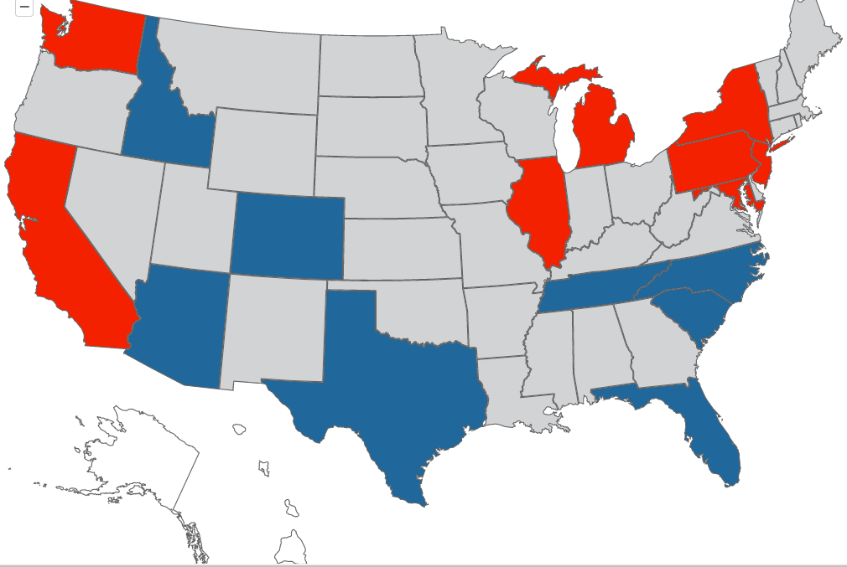

Project Statement
Between the years 2012 and 2018 North Carolina has regularly been identified as a top 5 inbound state by the US Migration Report*. The objective of our analysis is to drill into that fact and explore 2 things:
Given a net positive state inflow, has growth in NC counties been generally uniform OR have some counties/areas experienced significantly more growth? Test hypothesis that growth is limited to already densely populated areas.
2. For counties identified where strong inflow is identified through analysis, has the profile of these counties changed? To answer this question with balance we choose to analyze data through three lenses: Political , Economical & School Enrollment.
* A summary and interactive map of the US Migration Report can be found at: https://www.northamerican.com/migration-map

Slide 3
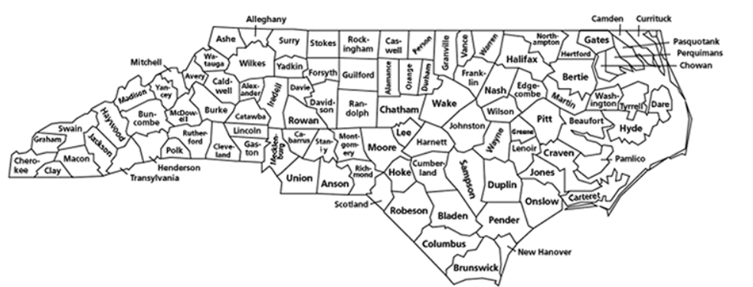
Part 1 – Identifying Growth Counties
Notes:
Quick Fact – There are exactly 100 counties in NC

Slide 4
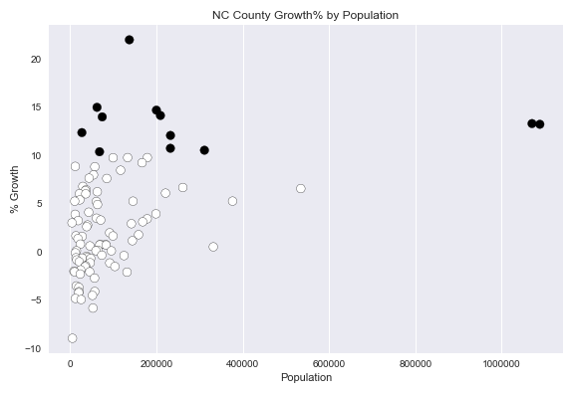
Initial County Plot
Goal:
Determine if there were counties with exceptional growth between 2012 and 2018 on a % basis.
Approach:
Sourced csv file with distinct rows for each county in NC.
Imported csv with Pandas and create basic data frame
Add empty columns to data frame to hold start and end year population as well as geo coordinates.
Using rest API and python loop populate columns population and coordinate columns.
Create calculated column for % change and Boolean column for high growth (> 10)
Used Matplotlib scatter plot to plot data frame
Source Code:
https://github.com/jasgarcia/NCGrowth/blob/master/NC_County_Growth.ipynb

Slide 5
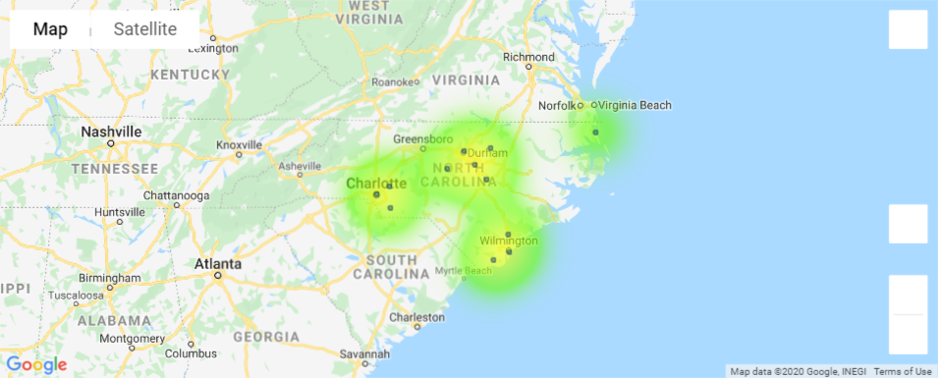
High Growth County Map Plot
Goal:
Use gmaps to plot high growth counties to highlight regional clusters.
Approach:
Created second data frame based on data frame assembled for initial scatter plot. This data frame only contained rows where growth > = 10%.
Created gmaps figure.
Added marker layer
Added heatmap
Source Code:
https://github.com/jasgarcia/NCGrowth/blob/master/NC_County_Growth.ipynb

Slide 6
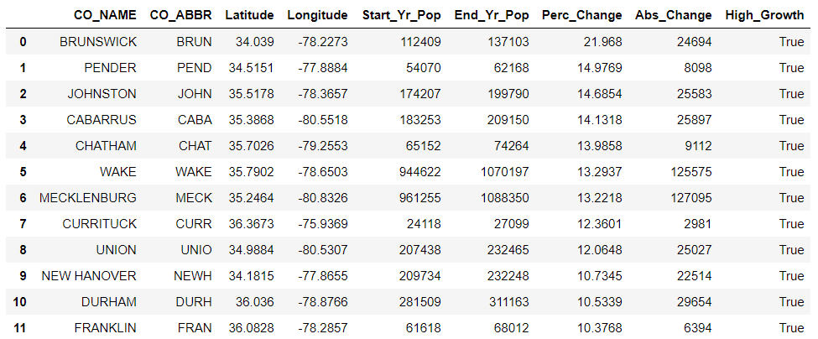
High Growth County Data Frame
Costal counties Brunswick and Pender are leading growth on a % basis..
The most densely populated counties Wake and Mecklenburg have the strongest absolute growth and with near identical rates of change in bot % and absolute terms.

Slide 7



Part 2– High Growth County Profile Trends
Government
Economy
Education
Notes:
Quick Fact – There are exactly 100 counties in NC

Slide 8
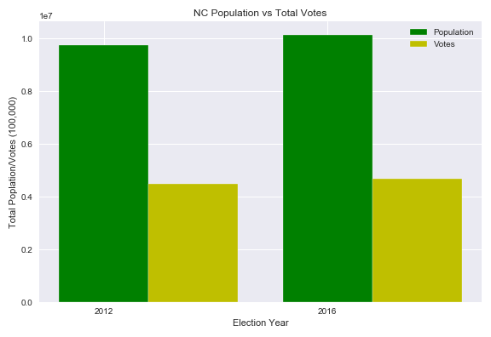
Voting in North Carolina
Data Source: North Carolina State Board of Elections
Goal: Explore voting trends in North Carolina between the 2012 and 2016 Presidential Elections
Approach:
1. Downloaded two CSV files from NCSBE website
2. Read CSV via Pandas
3. Isolated Presidential Elections and developed a dataframe based off county and party
Total Population 2012: 9,749,123
Total Votes 2012: 4,493,301
Percentage: 46.08%
Total Population 2016: 10,156,679
Total Votes 2012: 4,682,073
Percentage: 46.09%

Slide 9
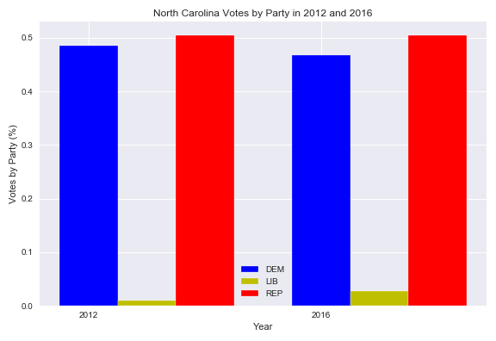
Voting in North Carolina
Approach Cont.
4. Breakdown of Voting by Party in NC
2012
Dem: 48.48%
Lib: 0.99%
Rep: 50.52%
2016
Dem: 46.76%
Lib: 2.78%
Rep: 50.46%

Slide 10
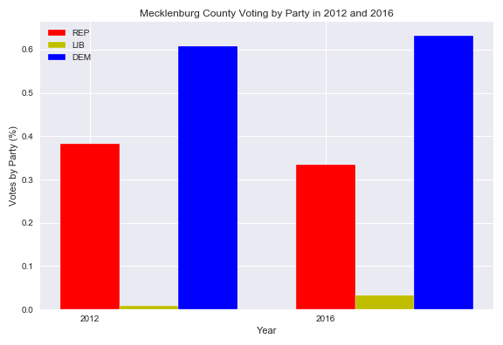
Voting in North Carolina
Approach Cont.
5. Look at the counties with the highest growth and compare to the counties with highest voting
Mecklenburg
9.96% (2012)
9.94% (2016)
Wake
10.79% (2012)
11.07% (2016)
6. Breakdown of how these counties voted by party
Mecklenburg
2012
Dem: 60.80%
Lib: 0.88%
Rep: 38.33%
2016
Dem: 63.27%
Lib: 3.33%
Rep: 33.4%

Slide 11
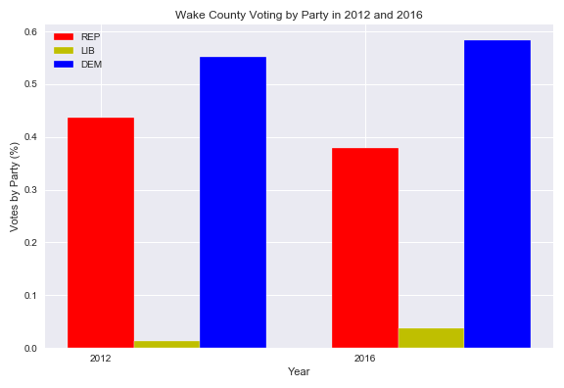
Voting in North Carolina
Wake County
2012
Dem- 55.10%
Lib- 1.27%
Rep- 43.63%
2016
Dem- 58.41%
Lib- 3.75%
Rep- 37.83%

Slide 12
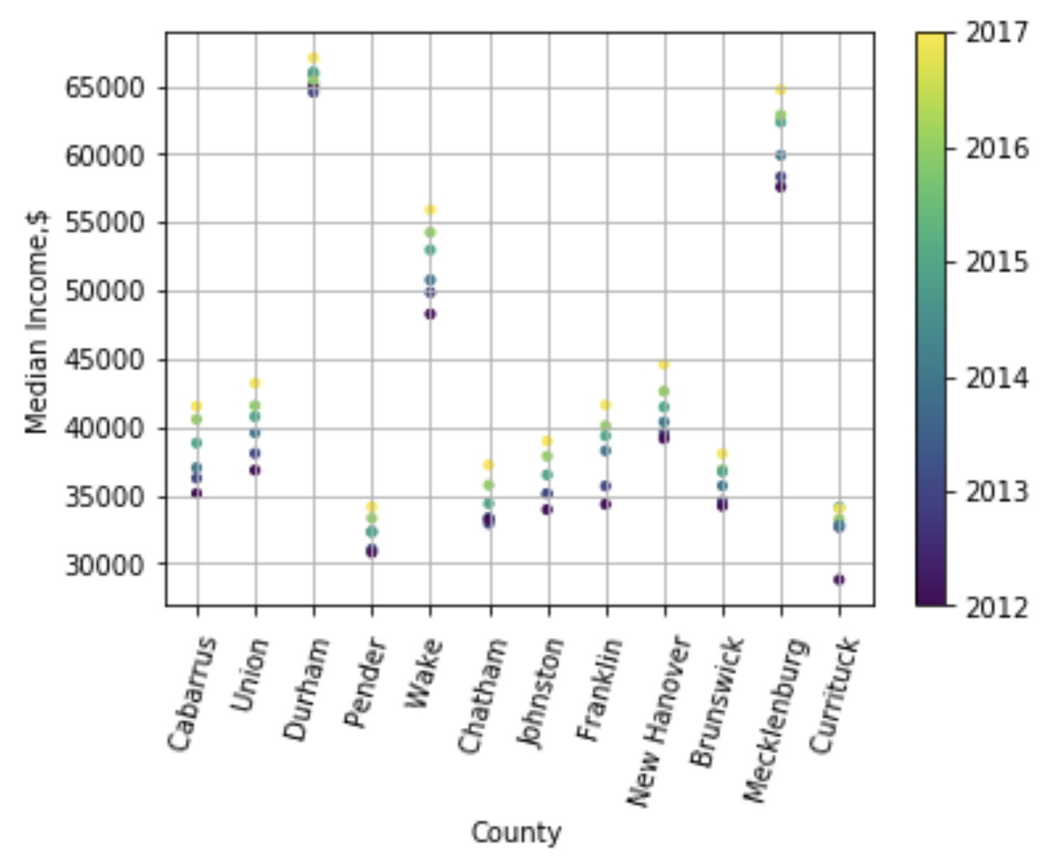
Median Income in High Growth Counties
Goal:
Evaluate change in median income per worker For high growth counties.
Approach:
Source CSV files from government site, filtered data.
Created dataframe of median income by year for high growth counties
Summarized data using .drop
Used Matplotlib to create scatter plot to include y axis and color bar.
Source Code:
https://github.com/jasgarcia/NCGrowth/blob/master/NC Growth Income.ipynb

Slide 13
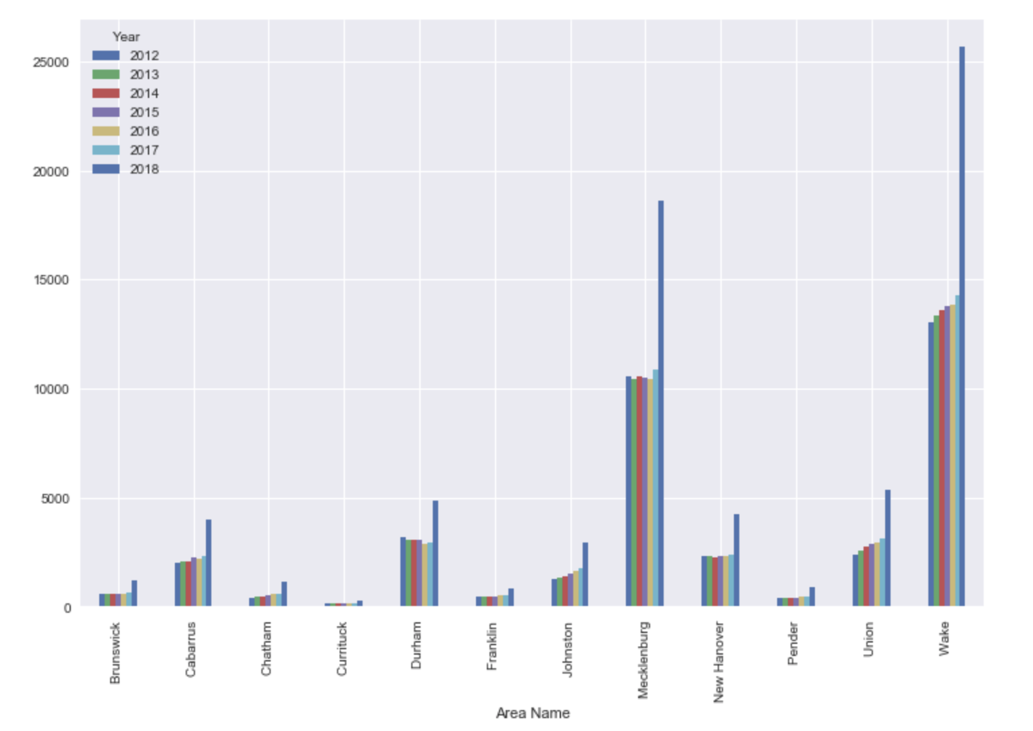
College Enrollment
Goal:
Evaluate college enrollment in high growth counties to see if there is any potential correlation between rising median incomes and college enrollment.
Approach:
Source college enrollment data from public websites to create CSV.
Import CSV to data frame.
Used Matplotlib to create bar chart to include years 2012-2018.
Source Code:
https://github.com/jasgarcia/NCGrowth/blob/master/College_level.ipynb

Slide 14
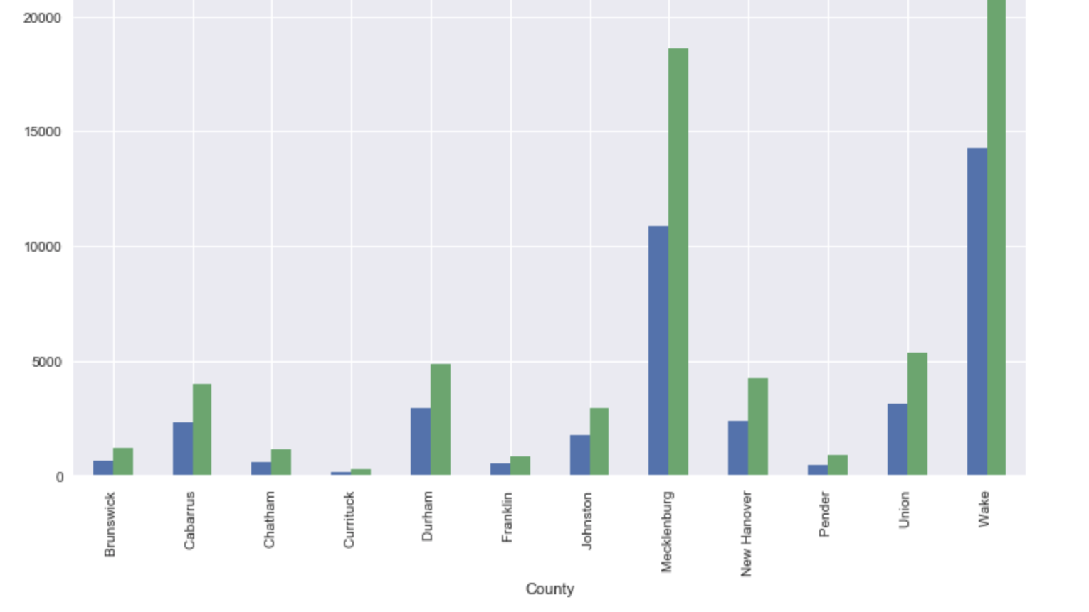
Source code: https://github.com/jasgarcia/NCGrowth/blob/master/College_level.ipynb

Slide 15
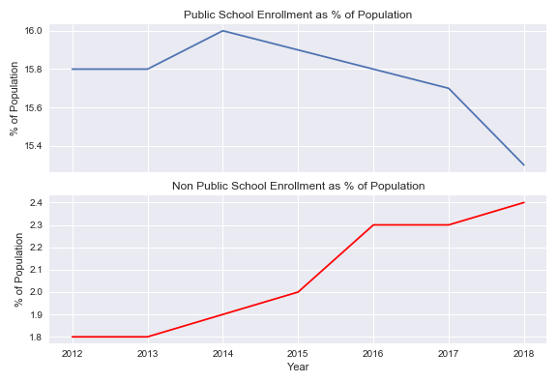
Public / Non Public School Enrollment in High Growth Counties
Goal:
Determine if the ratio between public and non public school enrollment is high growth counties changing
Approach:
Sourced csv files with school type enrollment by year, population, and file indicating high growth counties and loaded to dataframe.
Created calculated columns for % of population for each public vs non public and filtered for high growth counties.
Grouped on high growth counties to determine mean percentages.
Used Matplotlib sub plots to plot data on individual axes in same figure.
Source Code:
https://github.com/jasgarcia/NCGrowth/blob/master/NC_County_PubSchEnroll.ipynb

Slide 16
Conclusions /Where Next?
Conclusions:
North Carolina inflow growth is really only occurring in the Charlotte and Raleigh-Durham areas in absolute terms and in the Wilmington area in percentage terms.
There are indicators that the profile of these areas are becoming more affluent. Changes in political make up could have national implications.
Where Next:
More detailed analysis could be done on these high growth counties to answer a few important questions:
Is inflow likely to continue vis-à-vis are the factors that draw people to these areas likely to continue?
What is the impact of a growth on the less fortunate? E.g. Gentrification vs Better funded local social services…
How do the values measured for these counties compare to state and national trends?
Drill down to specific municipal areas in quantified high growth counties for impact studies.

Slide 17
Thank You
&
Any Questions
We could put our contact info here….

